Slide 1
Securing Azure IoT solutions
Notes:
Information in this document, including URL and other Internet Web site references, is subject to change without notice. Unless otherwise noted, the example companies, organizations, products, domain names, e-mail addresses, logos, people, places, and events depicted herein are fictitious, and no association with any real company, organization, product, domain name, e-mail address, logo, person, place or event is intended or should be inferred. Complying with all applicable copyright laws is the responsibility of the user. Without limiting the rights under copyright, no part of this document may be reproduced, stored in or introduced into a retrieval system, or transmitted in any form or by any means (electronic, mechanical, photocopying, recording, or otherwise), or for any purpose, without the express written permission of Microsoft Corporation.
Microsoft may have patents, patent applications, trademarks, copyrights, or other intellectual property rights covering subject matter in this document. Except as expressly provided in any written license agreement from Microsoft, the furnishing of this document does not give you any license to these patents, trademarks, copyrights, or other intellectual property.
The names of manufacturers, products, or URLs are provided for informational purposes only and Microsoft makes no representations and warranties, either expressed, implied, or statutory, regarding these manufacturers or the use of the products with any Microsoft technologies. The inclusion of a manufacturer or product does not imply endorsement of Microsoft of the manufacturer or product. Links may be provided to third party sites. Such sites are not under the control of Microsoft and Microsoft is not responsible for the contents of any linked site or any link contained in a linked site, or any changes or updates to such sites. Microsoft is not responsible for webcasting or any other form of transmission received from any linked site. Microsoft is providing these links to you only as a convenience, and the inclusion of any link does not imply endorsement of Microsoft of the site or the products contained therein.
© 2020 Microsoft Corporation. All rights reserved. Microsoft and the trademarks listed at https://www.microsoft.com/en-us/legal/intellectualproperty/Trademarks/Usage/General.aspx are trademarks of the Microsoft group of companies. All other trademarks are property of their respective owners.

Slide 2
Abstract and learning objectives
In this whiteboard design session, you will look at the process for designing an oil and gas manufacturing IoT solution that is secured end-to-end following best practices.
You will learn how to monitor and manage the security of all components in the solution You will also provide Contoso guidance on defining life cycles for particular components so that they have a plan that begins with initial deployment, to expected maintenance, to planned end-of-life and ultimately through decommissioning of the device so that they can understand how Azure supports this. Additionally, you will perform some threat modeling to help Contoso think about how they might handle STRIDE threats (spoofing of user identity, tampering, repudiation, information disclosure, denial of service, elevation of privilege).
At the end of this whiteboard design session, you will be better able to architect a comprehensive and secure oil and gas manufacturing IoT solution.

Slide 3
Step 1: Review the customer case study
Outcome
Analyze your customer needs.
Timeframe
15 minutes

Slide 4
Customer situation
Contoso, Ltd. has major holdings in one of the world’s most important oil-producing regions.
Their environments are very tough environments in which to work. The climate is hot, harsh, and unforgiving, and oil wells are often spaced many miles apart.
They want to deploy IoT technologies to electronically collect data and use cloud-based solutions to store and analyze it in order to gain new insights into well operations and future drilling possibilities.

Slide 5
Customer needs
Ensure that all IoT devices are properly registered and assigned a secure tamperproof identity.
Ensure devices are operating within assigned policy standards and are not tampered with.
Enable an alerting solution with little to no effort configuration that will notify and allow for remediation in the case of fault or malicious activity.
Ensure all events are surfaced in one place for simplicity.

Slide 6
Customer needs
Address the need to have auditing and monitoring across a wide range of device operating systems and processor architectures (Linux, x86, x64, etc.).
Automate the security agent provisioning rather than having to physically or remotely "touch" all the devices.
Ensure only the most secure protocols are implemented and used during any transmissions.
Ensure that in the future it will be possible to have an enterprise-wide look at any vulnerabilities or malicious events, not just specifically focused on the IoT infrastructure.
Contoso is currently using older, generic IoT devices but is considering upgrading those devices to something more secure and modern that will support future AI and Machine Learning activities. They would like to know if Microsoft has anything that can help them.

Slide 7
Customer objections
Contoso, Ltd staff are worried it may be impossible to manage the many thousands of IoT devices they have deployed around the world with any one product.
Can Azure handle all the different types of operating systems and processor architectures of their devices?
Will they be able to monitor for specific events on some of their proprietary devices?
Can Azure support non-TPM hardware devices?
Will the communications from a device to Azure be secure enough?

Slide 8
Customer objections
Can an Azure logging solution handle the massive amount of events and alerts that will need to be ingested?
Is it possible to assign role-based permissions based on their security objectives and policies to the IoT resources such as the Hub, Edge and individual devices?
Is the solution capable of being flexible in the types of reporting and alerts that can be generated based on custom logging event data?
Will we be able to limit the messages and network traffic to specific network IP addresses/subnets for our devices?
Can Microsoft provide a more modern solution to support their IoT device upgrades?

Slide 9
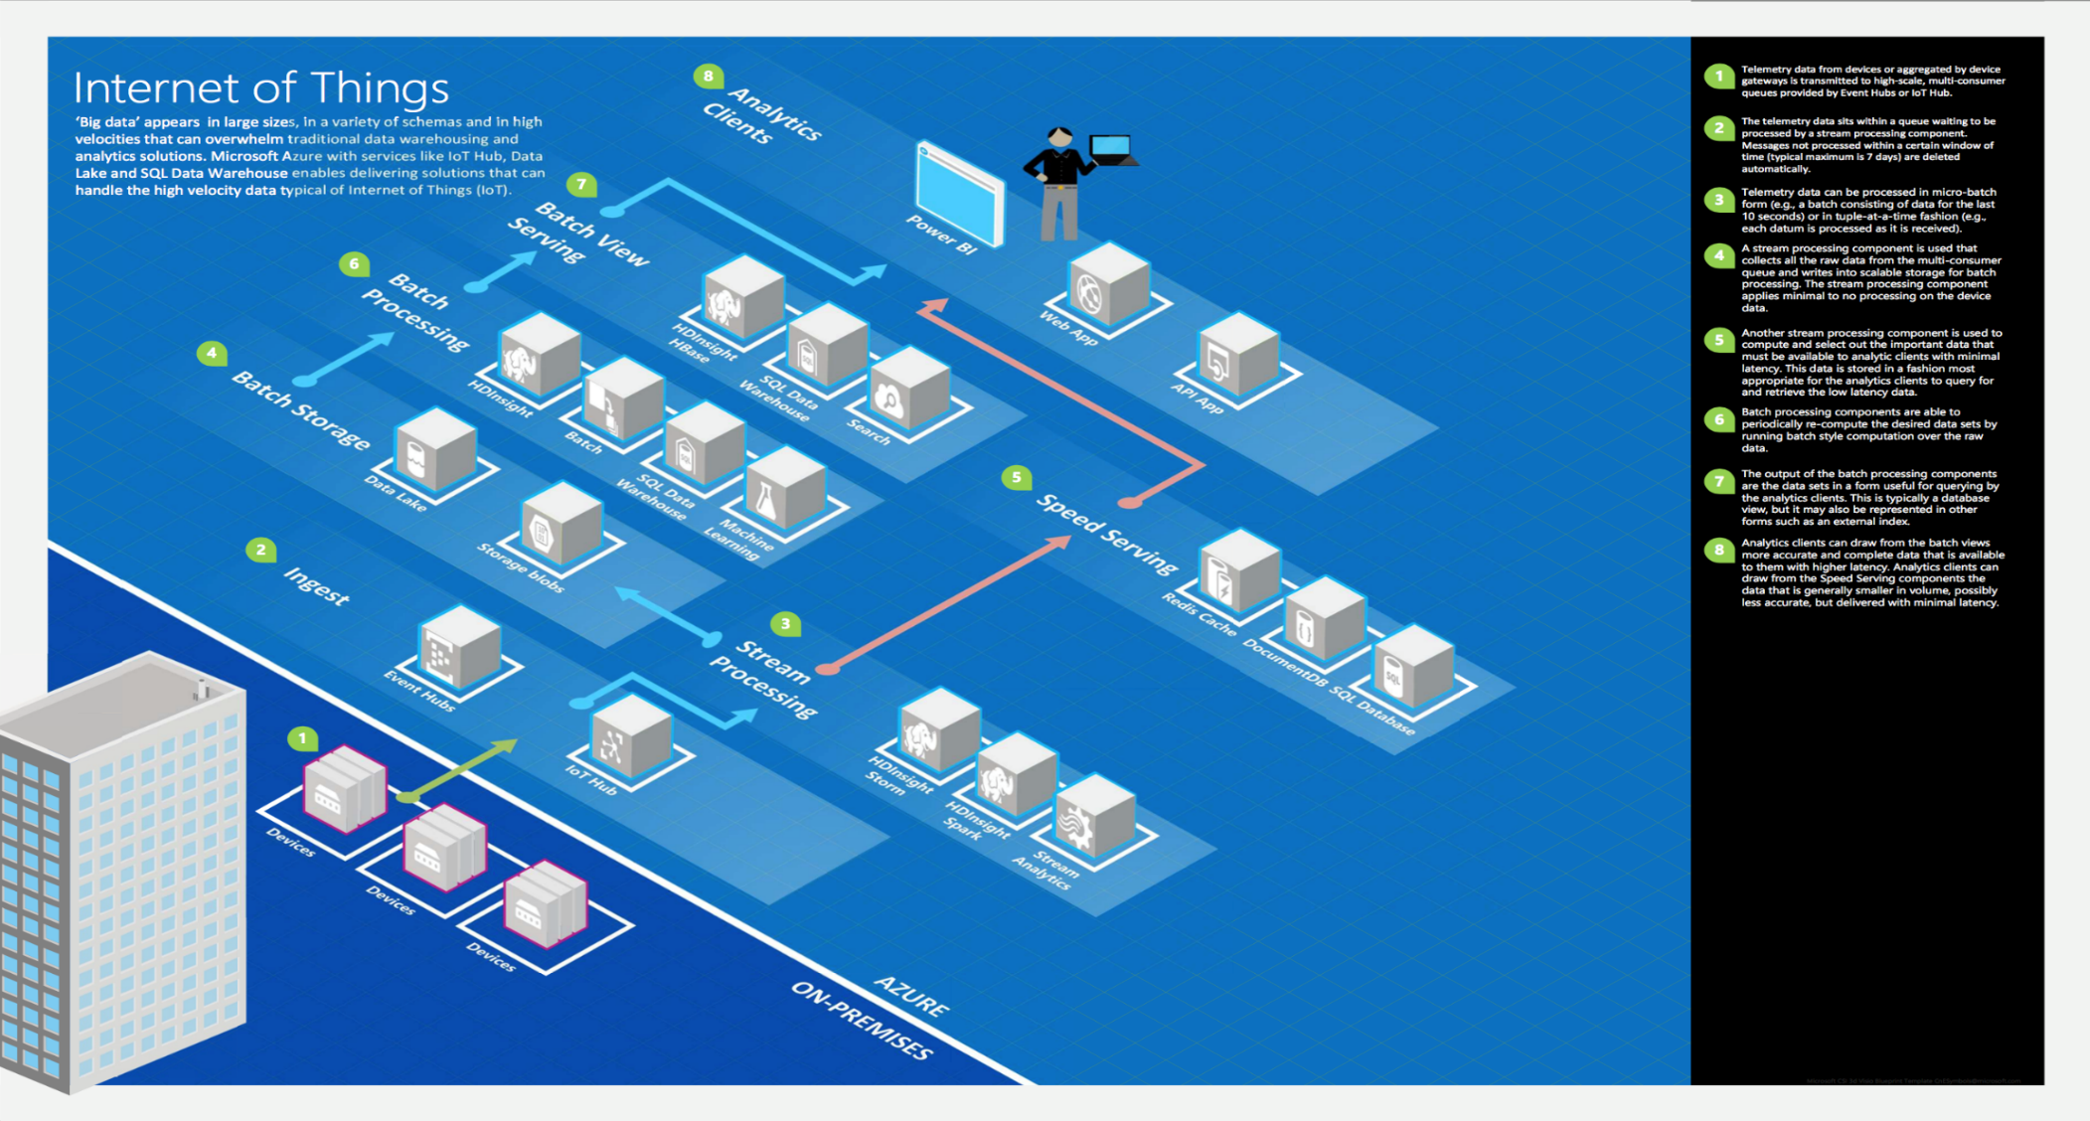
Common scenarios

Slide 10
Step 2: Design the solution
Outcome
Design a solution and prepare to present the solution to the target customer audience in a 15-minute chalk-talk format.
Timeframe
60 minutes
Business needs (10 minutes) | Respond to questions outlined in your guide and list the answers on a flipchart
Design (35 minutes) | Design a solution for as many of the stated requirements as time allows. Show the solution on a flipchart
Prepare (15 minutes) | Identify any customer needs that are not addressed with the proposed solution Identify the benefits of your solution Determine how you will respond to the customer’s objections Prepare for a 15-minute presentation to the customer

Slide 11
Step 3: Present the solution
Outcome
Present a solution to the target customer in a 15-minute chalk-talk format.
Timeframe
30 minutes (15 minutes for each team to present and receive feedback)
Directions
Pair with another table.
One table is the Microsoft team, and the other table is the customer.
The Microsoft team presents their proposed solution to the customer.
The customer asks one of the objections from the list of objections in the case study.
The Microsoft team responds to the objection.
The customer team gives feedback to the Microsoft team.

Slide 12
Wrap-up
Outcome
Identify the preferred solution for the case study.
Identify solutions designed by other teams.
Timeframe
15 minutes

Slide 13
Preferred target audience
IoT Developers and Support
Cloud Architects
Infrastructure Managers
Network Engineers

Slide 14
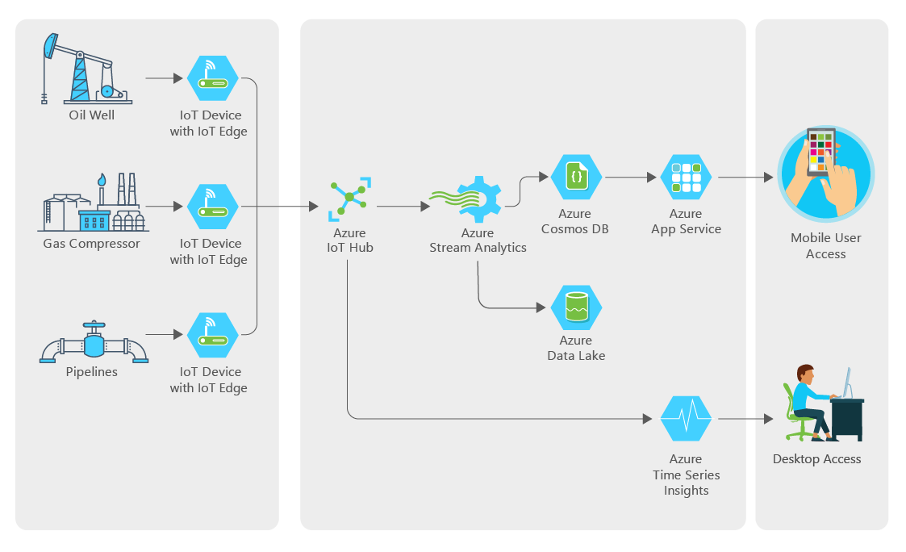
Preferred solution (High-Level)
Notes:
In the solution diagram above, note the following:
- IoT Edge devices are placed in the field.
- These devices communication back to the IoT Hub
- IoT Hub sends data to other services such as Cosmos DB and Time Series Insights
- Data is saved to Data Lake for analysis later by machine learning
- App services query Cosmos DB to provide mobile field techs information
Azure IoT Hubs will keep track of devices and allow for remote execution of commands, deployments and the receiving and routing of device messages.
Azure IoT Edge devices will be used to store information when offline and then forward to the IoT Hub.

Slide 15
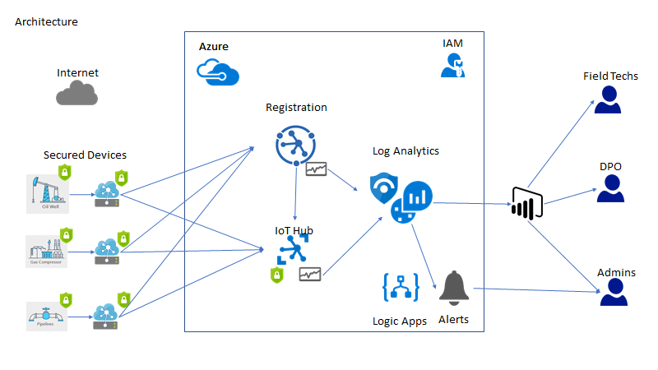
Preferred solution (Device Security)
Notes:
Describe how you will secure the following:
1. How will you secure the IoT Edge Devices?
Azure IoT Edge is inherently secure on its own through the Azure IoT Edge security manager daemon. However, any actor with access to the device as root or administrator can make changes to the device. For this reason, you should ensure that the device utilizes the Azure IoT Security Agent to monitor for security events or configuration changes that could affect the security integrity of the IoT Edge device.
2. How will you secure the IoT Devices?
Similar to an IoT Edge device, these devices should have the Azure IoT Security agent installed. Devices should also utilize hardware based secure silicon features (such as TPM, eSE, Arm TrustZone and Intel SGX) to ensure that the device is not accessed physically and modified in any way.
All devices should have unique certificates to identify them to the IoT Edge devices and the IoT Hub.
3. How will you monitor and audit device access?
Local device logs and security events can be sent to IoT Edge devices for storage, processing and possibly forwarding to the IoT Hub. Most major logs should be sent to the IoT Hub where you will have Azure Security Center for IoT monitoring those events and firing alerts on abnormal activity.
4. How will you monitor and audit Azure resource changes?
By enabling Diagnostic Logging on all Azure resources, you can have those events logged into a Log Analytics workspace.
5. How will you create custom alerts and execute remediation and investigation activities on detection?
Since all data will be ingested into Log Analytics, you can build any number of custom alerts to notify the proper individuals or execute Playbooks that start remediation or investigative activities.
6. What tools would you setup to surface audit and compliance reporting to IT Executives?
You can utilize Power BI to surface Log Analytics data into easy to read dashboards that are accessible only to the property individuals.

Slide 16



Preferred solution
Device Security
Use IoT Hub to manage devices, ingest all data, and send control data back to devices as needed.
Azure IoT Device Provisioning Service will be used to register the oil wells, gas compressors and pipelines devices with the appropriate IoT Hubs.
Process oil well data locally, detect anomalies, store data offline, and send only important data, using Azure IoT Edge devices.
Separately send oil pipeline metrics at regular intervals.
Notes:
Additional Resources:
Azure IoT Hub:
https://docs.microsoft.com/en-us/azure/iot-hub/about-iot-hub
Azure IoT Hub Device Provision Service:
https://docs.microsoft.com/en-us/azure/iot-dps/about-iot-dps

Slide 17
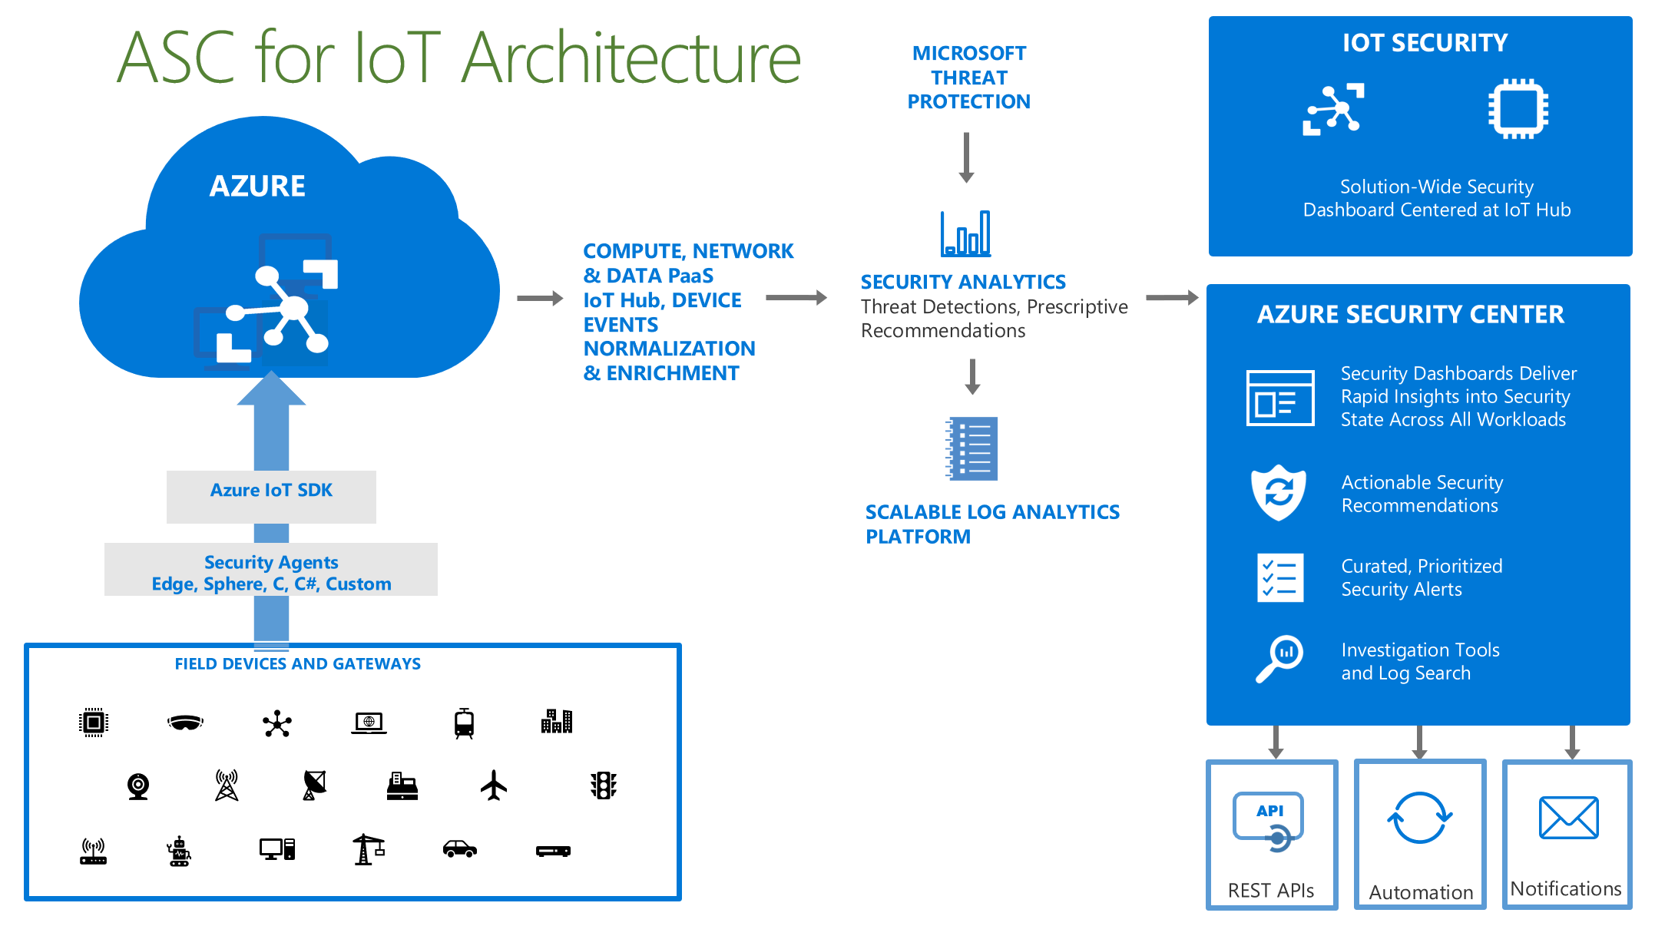
Preferred solution (Security)
Notes:
Describe how you will utilize Azure security features to secure the various resources such as the following:
How will you secure the IoT Hub?
Utilizing Azure Access control (IAM) mechanisms you can set the permissions to access and modify the IoT Hub resource to the proper individuals.
By implementing Shared Access Policies, you can create policies that grant permission to perform actions on the IoT Hub such as Registry read, Registry write, Service connect, and Device connect
Using IP Filters, you can limit the devices that can connect to your IoT hub to a set of IP Addresses.
Enabling Diagnostic settings to send changes to a Log Analytics workspace will enable to you fire alerts based on management plane activities.
How will you secure the IoT Device Provisioning Service?
Similar to an IoT Hub resource, you can utilize Azure Access Control (IAM) and a similar Shared Access Policies setup to achieve your desired permissions configuration.
You can also enable Diagnostic settings to log management plane changes.
Additional Resources:
Azure Security Center for IoT
https://docs.microsoft.com/en-us/azure/defender-for-iot/overview
Azure IoT SDKs:
https://docs.microsoft.com/en-us/azure/iot-hub/iot-hub-devguide-sdks
Azure Security Agent:
https://github.com/Azure/Azure-IoT-Security-Agent-C

Slide 18
Preferred solution
Security And Logging
Azure Security Agent will be deployed to all critical devices to feed important security events and data to Azure Security Center for IoT.
Log Analytics will be used to build custom alerts based on device security data ingested from the Azure Security Agents.
Azure Security Center for IoT will be used to provide workload protection through its intelligent threat detection analysis algorithms.

Slide 19
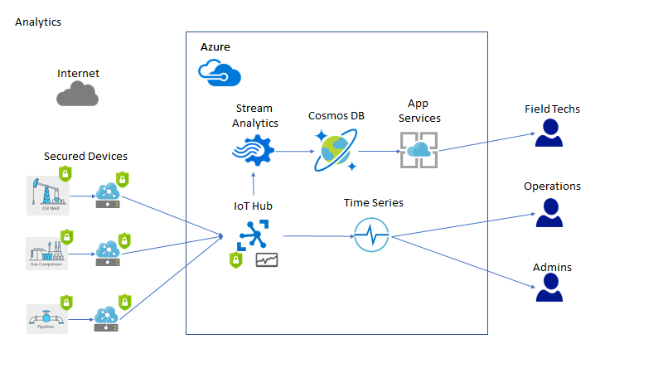
Preferred solution (Report/Analytics)
Notes:
In this diagram, IoT devices send data to the IoT Hub where it is then forwarded to Stream Analytics and Time Series.
Data is aggregated in Stream Analytics and then placed in Cosmos DB.
Machine Learning and other basic applications then query Cosmos DB to provide reporting and metrics to field techs.
Time Series data is analyzed by admin and operations staff.
Additional References:
Process real-time IoT data streams with Azure Stream Analytics:
https://docs.microsoft.com/en-us/azure/stream-analytics/stream-analytics-get-started-with-azure-stream-analytics-to-process-data-from-iot-devices
Azure Time Series Insights:
https://docs.microsoft.com/en-us/azure/time-series-insights/time-series-insights-overview
Azure Stream Analytics:
https://docs.microsoft.com/en-us/azure/stream-analytics/stream-analytics-introduction

Slide 20


Preferred solution
Reporting and Analytics
Stream Analytics can monitor device data for alert thresholds and separately send all device data to Cosmos DB.
Use Cosmos DB to store reference data, alert information, device data, and oil well metrics used for detecting anomalies and output efficiency.
Overlay device telemetry and other data all in one place, automatically handle schema changes and view raw data.
Custom web app hosted in Web Apps service, accesses time series data via Time Series Insights Query APIs, connects to Cosmos DB for reference data, and manages IoT devices through IoT Service SDK.
Use Azure Time Series Insights to store, visualize, and query all-time series data from IoT and edge devices.

Slide 21
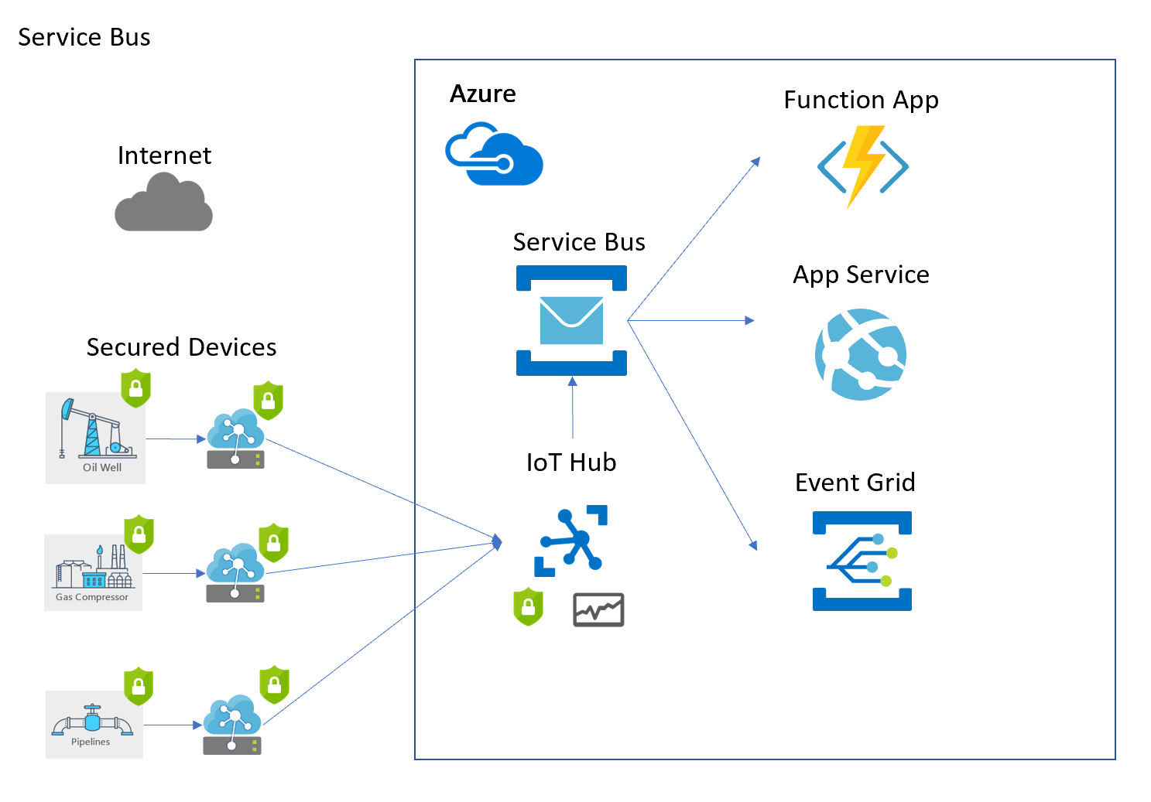
Preferred solution (Service Bus)
Notes:
In addition to Stream Analytics and Time Series Insights, Azure Service Bus can be connected to the IoT Hub to receive messages and then allow other custom applications to process the messages the are specifically looking for, at their own respective pace.
Additional References:
IoT Hub Messaging:
https://docs.microsoft.com/en-us/azure/iot-hub/iot-hub-devguide-messages-d2c
Azure Service Bus:
https://docs.microsoft.com/en-us/azure/service-bus-messaging/service-bus-messaging-overview

Slide 22
Preferred solution
Service Bus
Use custom endpoints and routes in IoT Hub to filter and send critical messages to a Service Bus Queue for further processing.
Service Bus Subscribers such as Azure Functions, App Services and Event Grid can monitor for specific messages

Slide 23
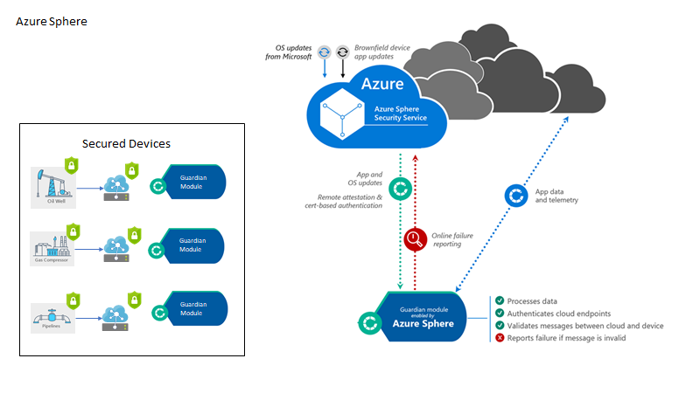
Preferred solution (Azure Sphere)
Notes:
Each of the remote devices has a guardian module that performs secure communication with Azure Sphere. App and other updates are securely delivered over the internet to the devices.
1. How will Contoso ensure they can push updates to the field in a secure manner?
Azure Sphere can be used to deploy Guardian modules that will allow for the secure updates of the devices over the internet.
Additional resources:
Guardian Modules:
https://docs.microsoft.com/en-us/azure-sphere/hardware/guardian-modules
Starbucks use-case:
https://azure.microsoft.com/en-us/blog/azure-sphere-guardian-module-simplifies-secures-brownfield-iot/#:~:text=Using%20the%20Azure%20Sphere%20guardian,failure%20reporting%2C%20and%20software%20updates.
What is Azure Sphere:
https://docs.microsoft.com/en-us/azure-sphere/product-overview/what-is-azure-sphere

Slide 24
Preferred solution
Azure Sphere
Integrate brownfield IoT Devices with Azure Sphere to enable secure 2-way communications and no-touch device upgrades
Utilize Guardian Module to secure the communications between devices and internet and Azure Sphere Security Service
Notes:
Starbucks use-case (Azure Sphere) https://news.microsoft.com/transform/starbucks-turns-to-technology-to-brew-up-a-more-personal-connection-with-its-customers/
Guardian Modules - https://azure.microsoft.com/en-us/blog/guardian-modules-bringing-azure-sphere-security-to-brownfield-iot

Slide 25
Preferred objections handling
Contoso, Ltd staff are worried it may be impossible to manage the many thousands of IoT devices they have deployed around the world with any one product.
Can Azure handle all the different types of operating systems and processor architectures of their devices?
Will they be able to monitor for specific events on some of their proprietary devices?
Can Azure support non-TPM hardware devices?
Notes:
Contoso, Ltd staff are worried it may be impossible to manage the many thousands of IoT devices they have deployed around the world with any one product.
Utilizing the Azure IoT Hub Device Provisioning Service, Contoso can enable a zero-touch, just-in-time provisioning to specific IoT hubs without any human intervention. The service scales to many millions of devices in a secure and scalable manner that will meet Contoso's needs.
Can Azure handle all the different types of operating systems and processor architectures of their devices?
The Azure IoT Agents have been released with ANSI-C standards in mind. The code is freely available on GitHub along with an entire SDK that will enable Contoso to easily re-compile the source for any target device.
Will they be able to monitor for specific events on some of their proprietary devices?
Yes, they can monitor for custom events on their proprietary devices using the Azure IoT SDK to send message and events to their specific IoT Hub(s).
Can Azure support non-TPM hardware devices?
Yes, you can recompile the source code to utilize simulated/software TPMs, however this is not a standard or accepted way of doing secure device management in production environments.

Slide 26
Preferred objections handling
Will the communications from a device to Azure be secure enough?
Can an Azure logging solution handle the massive amount of events and alerts that will need to be ingested?
Is it possible to assign role-based permissions based on their security objectives and policies to the IoT resources such as the Hub, Edge and individual devices?
Is the solution capable of being flexible in the types of reporting and alerts that can be generated based on custom logging event data?
Notes:
Will the communications from a device to Azure be secure enough?
Absolutely, the Azure IoT SDKs come with support for several different protocols including the latest HTTPS and SSL features.
Can an Azure logging solution handle the massive amount of events and alerts that will need to be ingested?
Yes, at the lowest plan level, you can send 500MB of data to a Log Analytics workspace. Standard and Premium plans have no limit on the amount of data uploaded even if it is terabytes per day.
Is it possible to assign role-based permissions based on their security objectives and policies to the IoT resources such as the Hub, Edge and individual devices?
Yes, Azure IoT resources come with a management plane that gives you flexibility to allow various levels of permissions to target specific roles of your IoT Infrastructure.
Is the solution capable of being flexible in the types of reporting and alerts that can be generated based on custom logging event data?
Yes, you can choose to utilize the out of box alert templates, or create your own templates based on common Azure and Operating System events, or even your own custom events.

Slide 27
Preferred objections handling
Will we be able to limit the messages and network traffic to specific network IP addresses/subnets for our devices?
Can Microsoft provide a more modern solution to support their IoT device upgrades?
Notes:
Will we be able to limit the messages and network traffic to specific network IP addresses/subnets for our devices?
Yes, you can enable IP Filtering in the IoT Hub to ensure that only messages that originate from specific IPs or subnet are allowed to flow through to the IoT Hub(s).
Can Microsoft provide a more modern solution to support their IoT device upgrades?
Yes, using Azure Sphere, the customer can upgrade their devices using new hardware designed with security and flexibility in mind. Reference this Microsoft research paper for details of what makes devices secure.

Slide 28
Customer quote
"Managing our massive worldwide IoT Infrastructure using the latest security features of Azure has given us the confidence to know our devices are running securely and efficiently with the added flexibility to change our direction at any time. Azure Sphere presents us with a path to support our future needs."
Jack Tradewinds, CIO of Contoso, Ltd.

